Slide 1
Chapter 2

Slide 2
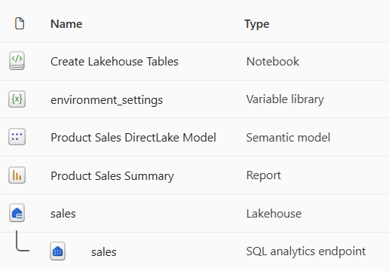
solution workspace

Slide 3
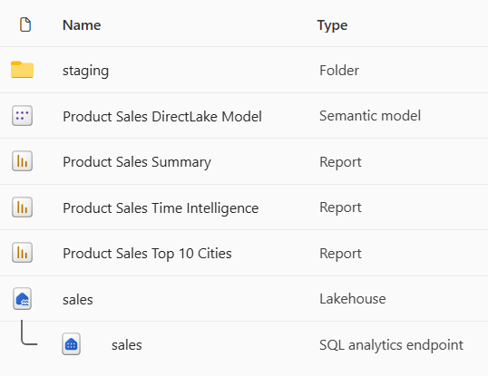
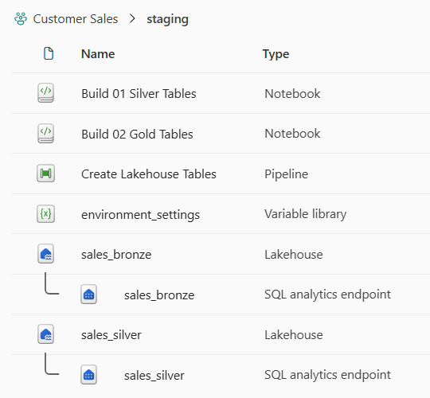
solution workspace

Slide 4
presentation workspace
staging workspace

Slide 5


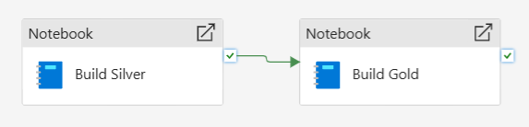
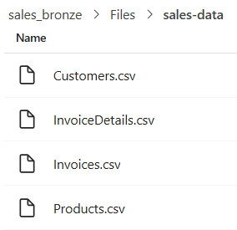
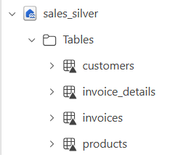
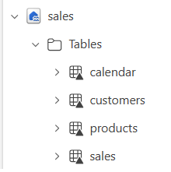


Fabric Solution Workspace
Create Lakehouse Tables
Azure Storage
Account
Bronze Lakehouse
Silver Lakehouse
Gold Lakehouse
ADLS Gen2
Shortcut
Build
Silver
Build
Gols

Slide 6
dev environment
test environment
prod environment
Fabric Workspace
Fabric Workspace
Fabric Workspace
Fabric capacity (F4)
Fabric capacity (F16)
Fabric capacity (F64)

Slide 7
dev environment
test environment
prod environment
Fabric Workspace
Fabric Workspace
Fabric Workspace
Fabric capacity (F4)
Fabric capacity (F16)
Fabric capacity (F64)
Azure Storage Account
used to store dev data files
Azure Storage Account
used to store test data files
Azure Storage Account
used to store prod data files
Fabric Connection
to dev storage account
Fabric Connection
to test storage account
Fabric Connection
to prod storage account

Slide 8
GIT Repository
GIT Repository
branches
branches
main
main (default)
test
dev (default)

Slide 9
GIT Repository
branches
workflows/pipelines
environments
main (default)
sync-dev-workspace
dev
deploy-to-test
test
deploy-to-prod
prod

Slide 10



Staging Workspace
Presentation Workspace
Bronze Layer
Silver Layer
Gold Layer
Presentation Layer
Notebook
Lakehouse
Notebook
Lakehouse
Notebook
Lakehouse
Semantic Model
Report
Solution Workspace
Bronze Layer
Silver Layer
Gold Layer
Presentation Layer
Notebook
Lakehouse
Notebook
Lakehouse
Notebook
Lakehouse
Semantic Model
Report

Slide 11
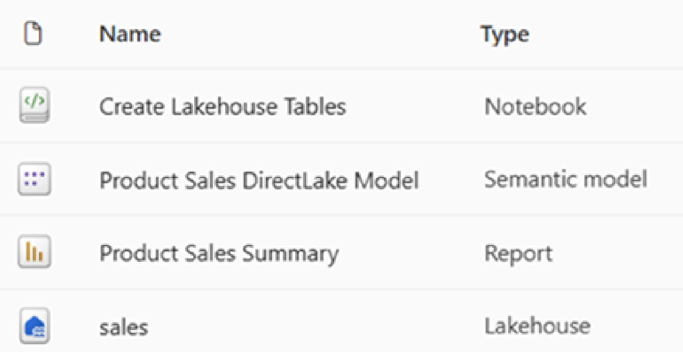

Slide 12
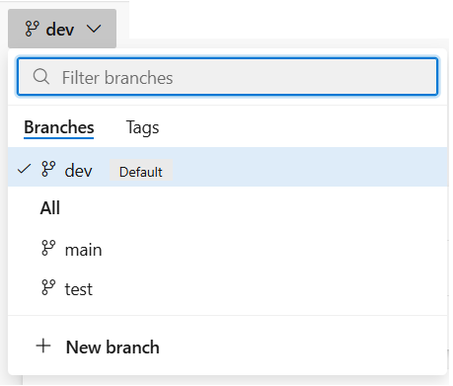
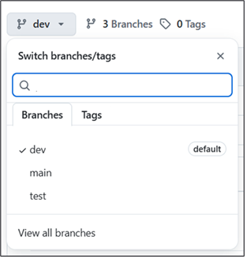
Creating a GIT Repository in GitHub

Slide 13
GIT Repository
branches
prod
workspace
main
test
workspace
test
dev
dev
workspace

Slide 14
feature
workspace
dev
workspace
test
workspace
prod
workspace
feature
workspace
feature
workspace
dev capacity
F4
test capacity
F16
prod capacity
F64

Slide 15
dev environment
test environment
prod environment
Entra Id Application
used to authenticate as SPN
Entra Id Application
used to authenticate as SPN
Entra Id Application
used to authenticate as SPN
Azure Key Vault
used to secure SPN credentials
Azure Key Vault
used to secure SPN credentials
Azure Key Vault
used to secure SPN credentials
Azure Storage Account
used to store data files
Azure Storage Account
used to store data files
Azure Storage Account
used to store data files
Fabric capacity (F4)
Fabric capacity (F16)
Fabric capacity (F64)
Fabric Workspace
Fabric Workspace
Fabric Workspace
Fabric Connection
to Azure storage account
Fabric Connection
to Azure storage account
Fabric Connection
to Azure storage account

Slide 16
dev
workspace
test
workspace
prod
workspace

Slide 17
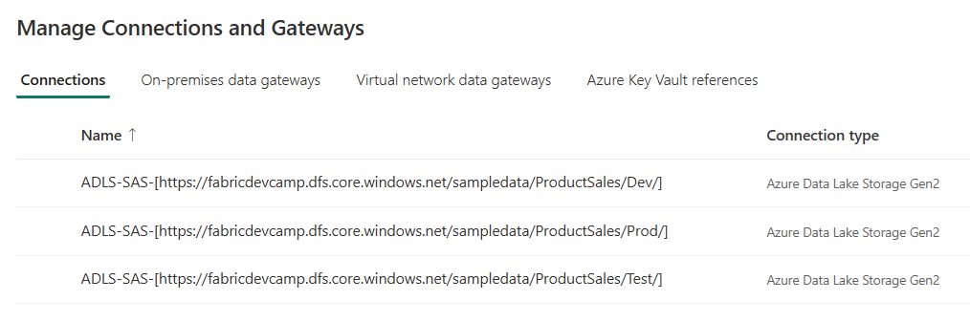

Slide 18
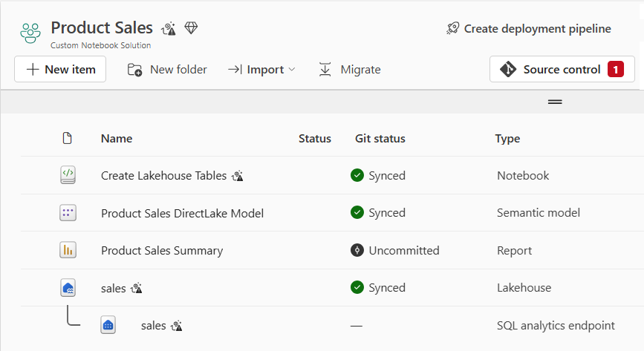

Slide 19
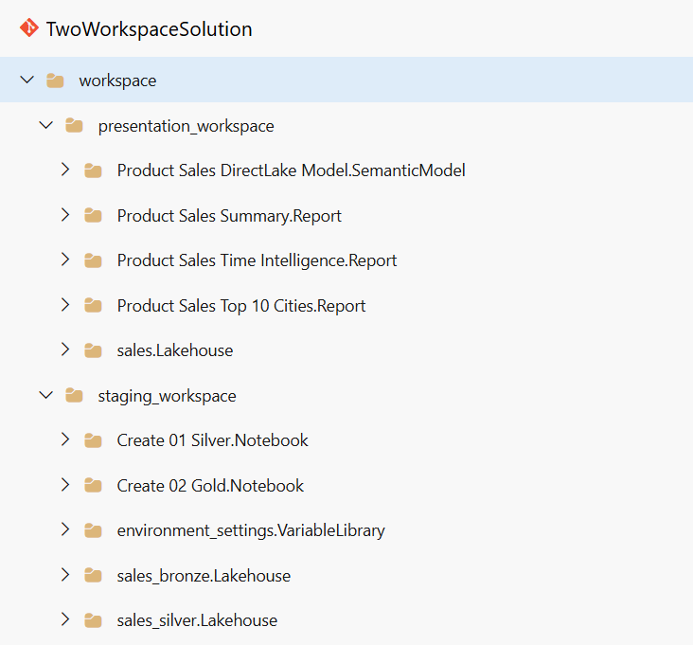
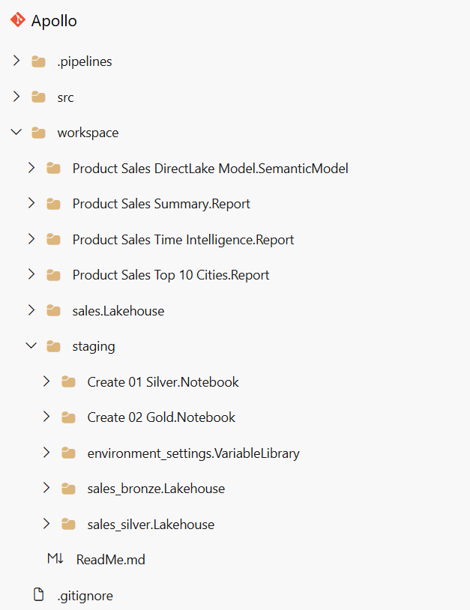

Slide 20
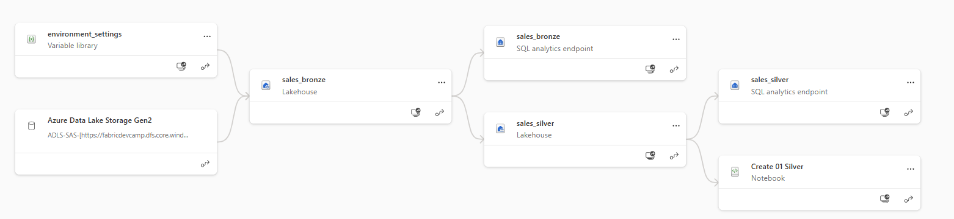
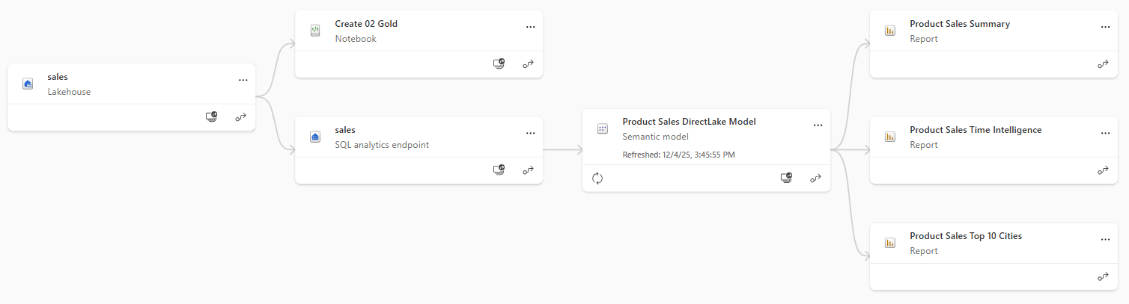

Slide 21
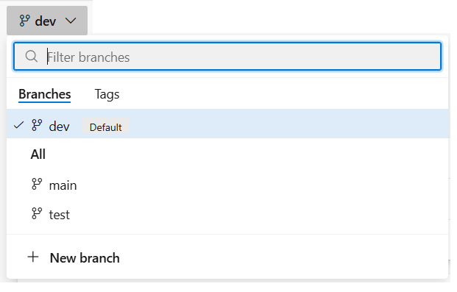
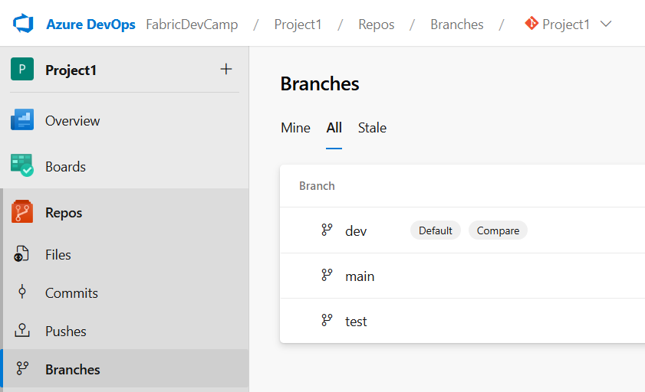
Creating a GIT Repository in Azure DevOps

Slide 22
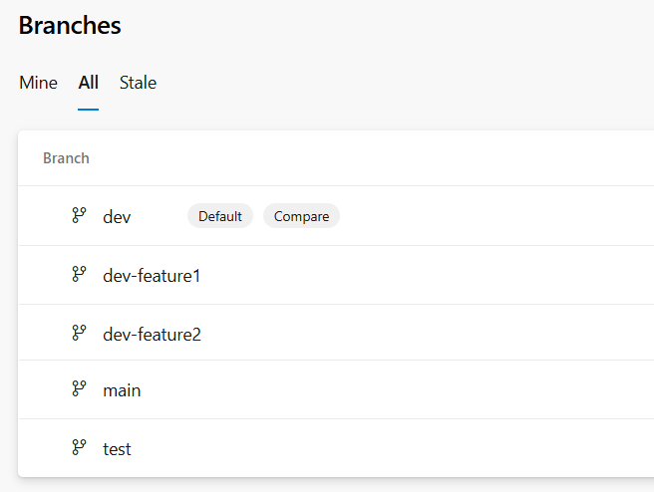
Developer 1
merge changes
shared
codebase
Developer 2
merge changes
Developer N
merge changes

Slide 23
Dev
workspace
Test
workspace
Prod
workspace
dev
branch
test
branch
main
branch

Slide 24
Dev
workspace
Test
workspace
Prod
workspace
feature
workspace
feature
branch
dev
branch
test
branch
main
branch
feature
workspace
feature
branch

Slide 25
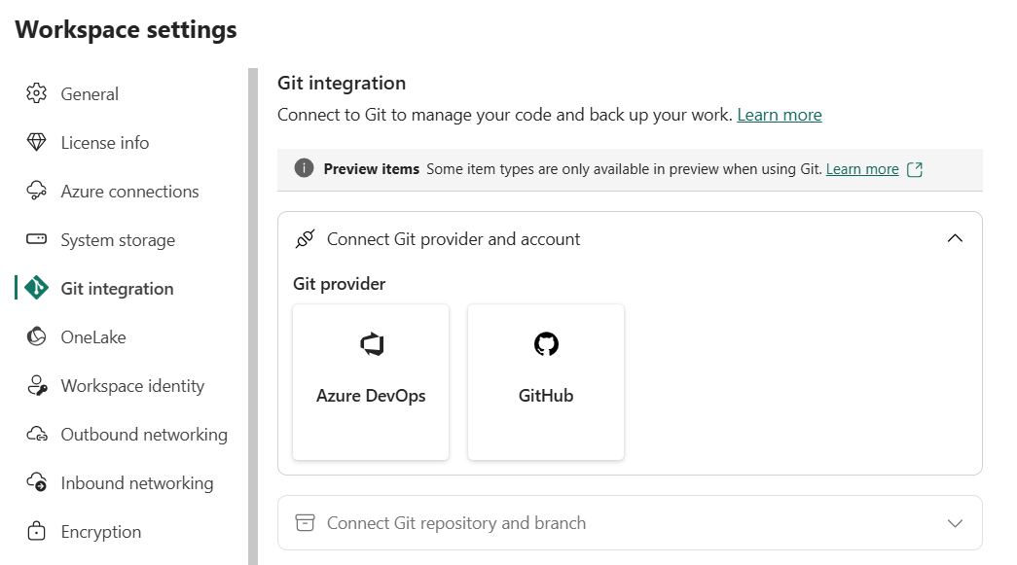

Slide 26
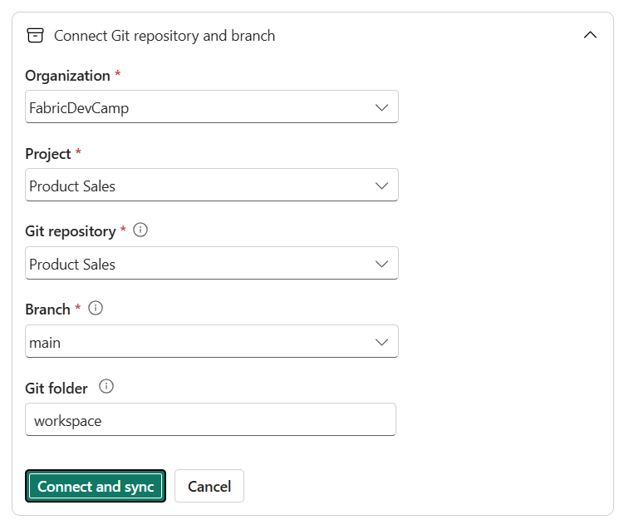

Slide 27
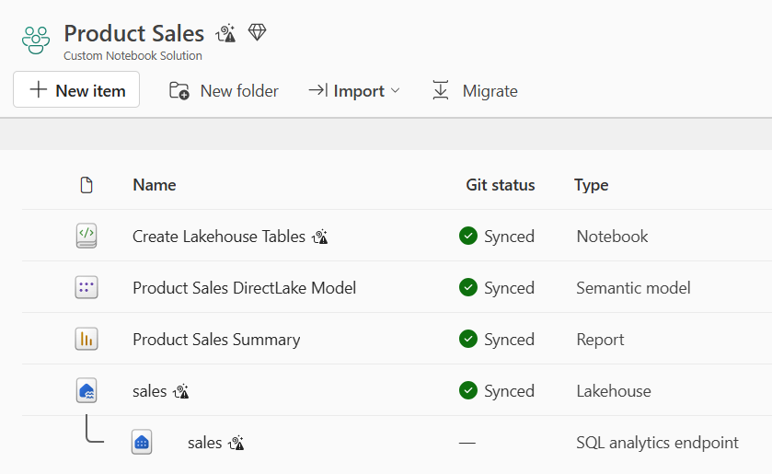

Slide 28
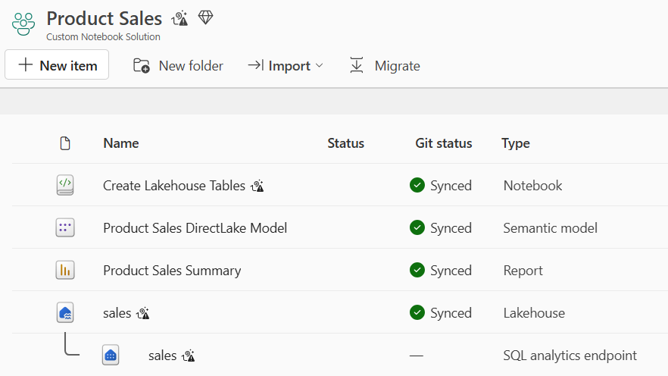
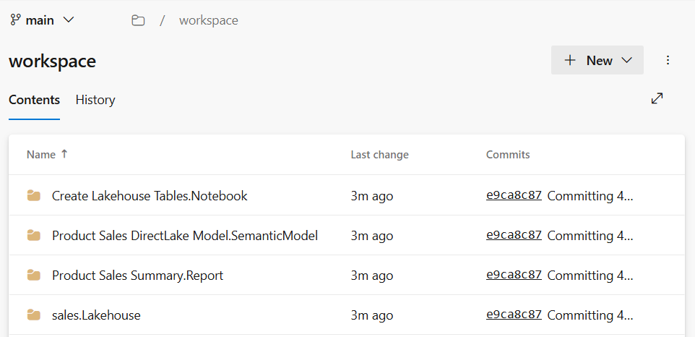
Sync to Git

Slide 29
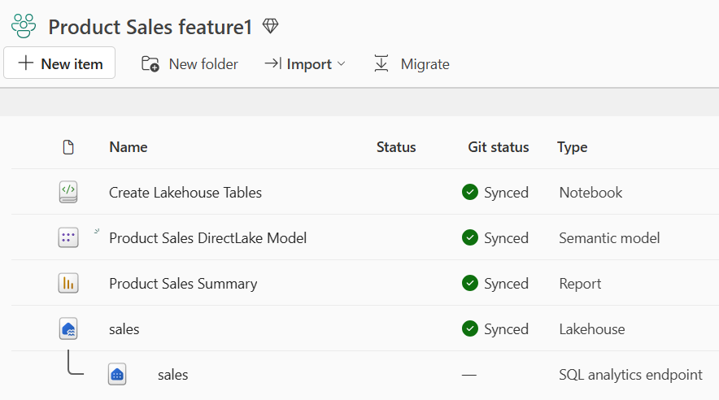
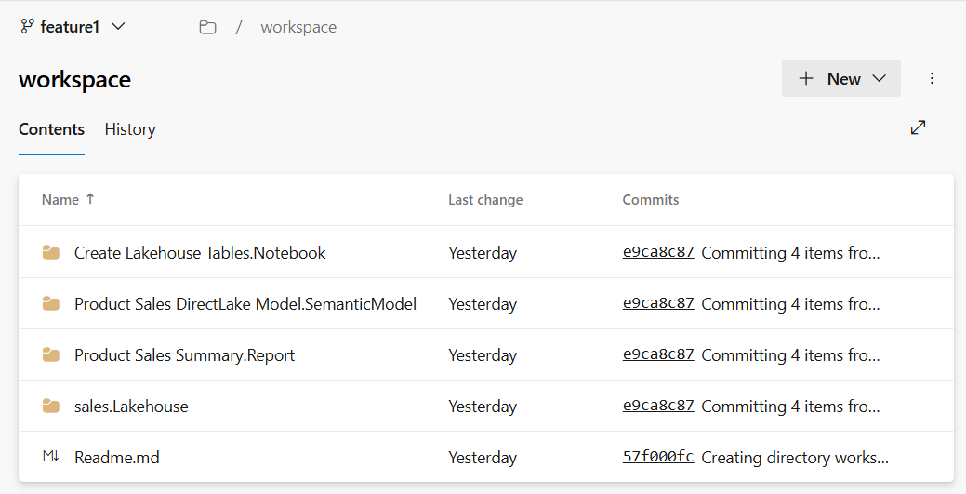
Sync to Workspace

Slide 30
feature 1
workspace
feature 1
branch
integration
branch
2-way sync
merge
feature 2
workspace
feature 2
branch
2-way sync
merge
feature N
workspace
feature N
branch
2-way sync
merge

Slide 31
Prod
workspace
feature
workspace
feature
branch
main
branch
feature
workspace
feature
branch

Slide 32
Fabric Deployment Pipeline
dev
workspace
test
workspace
prod
workspace
Deploy
Deploy

Slide 33
Fabric Deployment Pipeline
dev
workspace
test
workspace
prod
workspace
Deploy
Deploy
GIT
SYNC
feature
workspace
feature
branch
main
branch
feature
workspace
feature
branch

Slide 34
workspace
Notebook
Pipeline
Variable Library
Copyjob
var1 - string - 'foo'
var2 - string - 'bar'
var3 - integer - 42
Dataflow
OneLake Shortcut

Slide 35
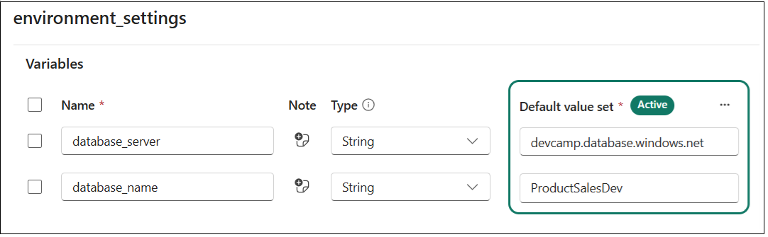

Slide 36
Variable Name | Type | Default Value
database_server | String | devcamp.database.windows.net
database_name | String | product-sales-dev

Slide 37
Variable Library
Value Sets
Variable Name | Type | Default Value
database_server | String | dev value
database_name | String | dev value
test
test value
test value
prod
prod value
prod value

Slide 38
dev workspace
test workspace
prod workspace
Variable Library
Variable Library
Variable Library
default value set (active)
test value set
prod value set
default value set
test value set (active)
prod value set
default value set
test value set
prod value set (active)

Slide 39
Workspace Item Types by Workload
Data Factory
Data Engineering
Power BI
DataPipeline
Lakehouse
SemanticModel
Dataflow
Notebook
Report

Slide 40
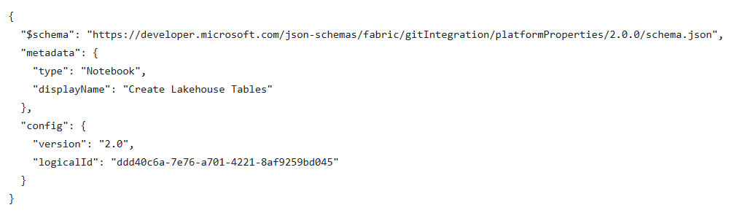

Slide 41
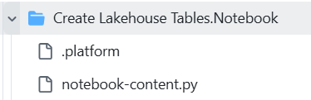
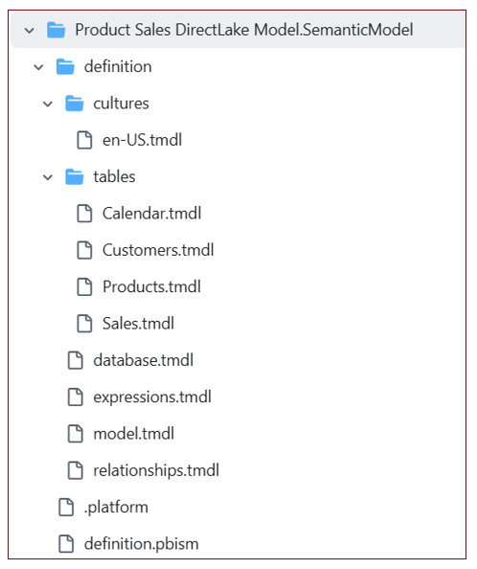
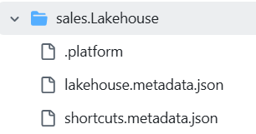

Slide 42
feature workspace
dev workspace
prod workspace
Workspace Item
Workspace Item
Workspace Item
displayName | sales
type | Lakehouse
id | 11111111-1111-1111-1111-111111111111
displayName | sales
type | Lakehouse
id | 22222222-2222-2222-2222-222222222222
displayName | sales
type | Lakehouse
id | 33333333-3333-3333-3333-333333333333
feature workspace
dev workspace
prod workspace
Workspace Item
Workspace Item
Workspace Item
displayName | sales
type | Lakehouse
id | 11111111-1111-1111-1111-111111111111
logicalId | AAAAAAAA-AAAA-AAAA-AAAA-AAAAAAAAAAAA
displayName | sales
type | Lakehouse
id | 22222222-2222-2222-2222-222222222222
logicalId | AAAAAAAA-AAAA-AAAA-AAAA-AAAAAAAAAAAA
displayName | sales
type | Lakehouse
id | 33333333-3333-3333-3333-333333333333
logicalId | AAAAAAAA-AAAA-AAAA-AAAA-AAAAAAAAAAAA

Slide 43
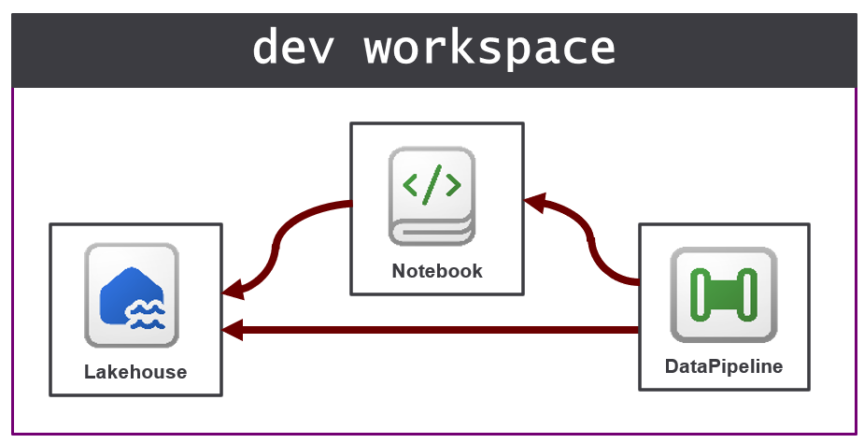
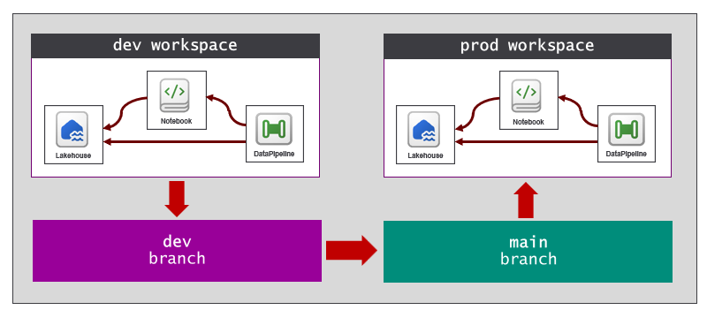
Images need to be recreated in PPT objects

Slide 44
CI/CD Task 1
API call
Microsoft Azure Fabric REST APIs
CI/CD Task 2
API call
Fabric REST APIs
CI/CD Task 3
API call
Power BI REST APIs
CI/CD Task 4
API call
Tabular Object Model (TOM)
CI/CD Task 5
API call
Azure Data Lake Storage (ADLS) Gen2 APIs
CI/CD Task 6
API call
Azure DevOps Services REST API
CI/CD Task 7
API call
GitHub REST APIs

Slide 45

Azure DevOps
Fabric Environment
Fabric Workspace
Azure
Pipeline
Fabric Notebook
Run Notebook

Slide 46
Item
Definition
Create Item
Fabric
REST
APIs
Item
Definition
Update Item Definition
Item
Definition
Get Item Definition

Slide 47
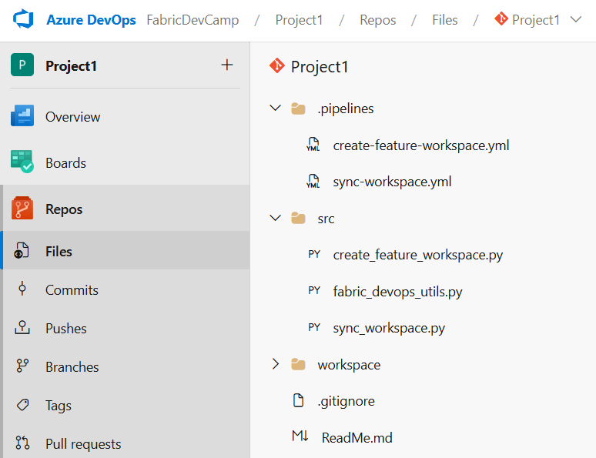

Slide 48
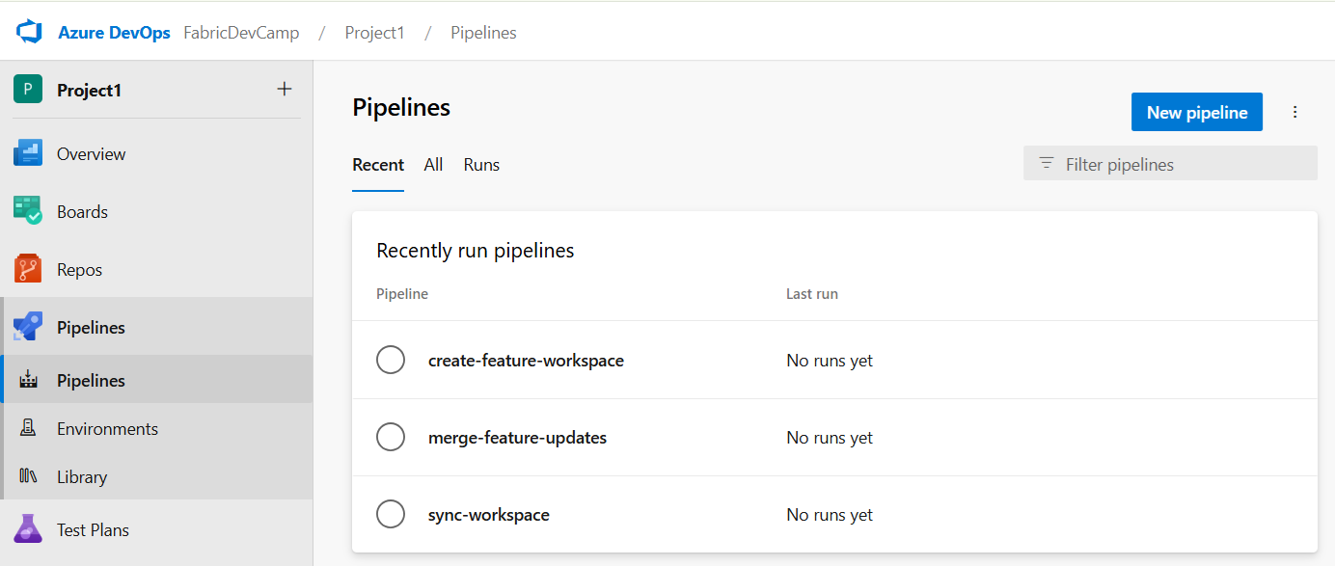

Slide 49
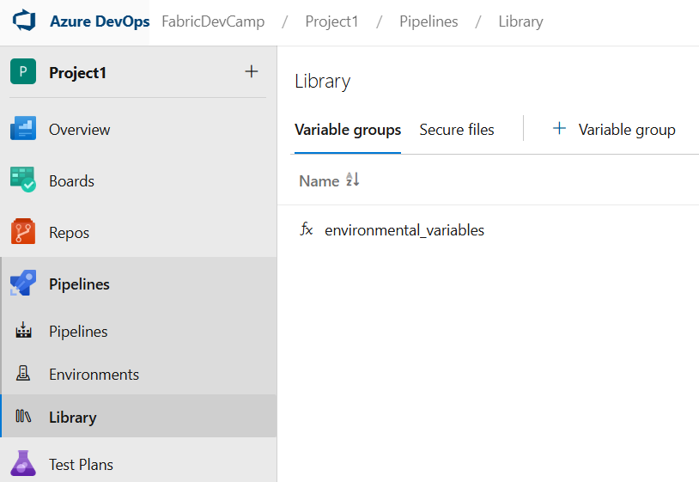
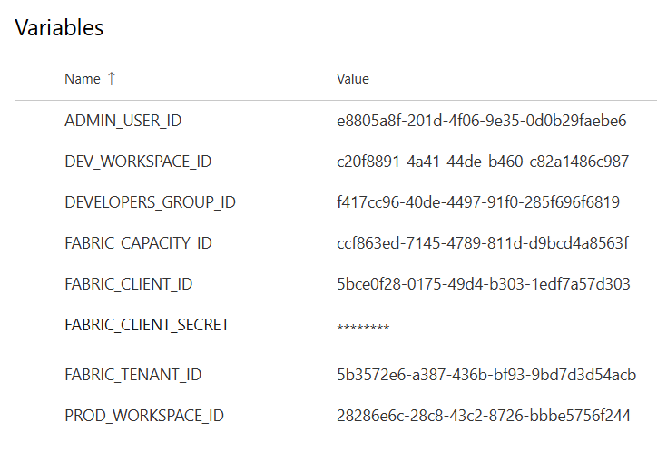

Slide 50
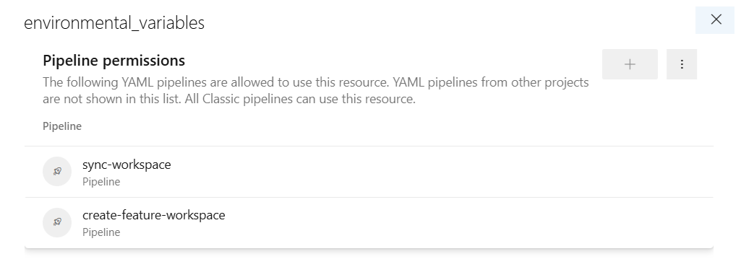

Slide 51
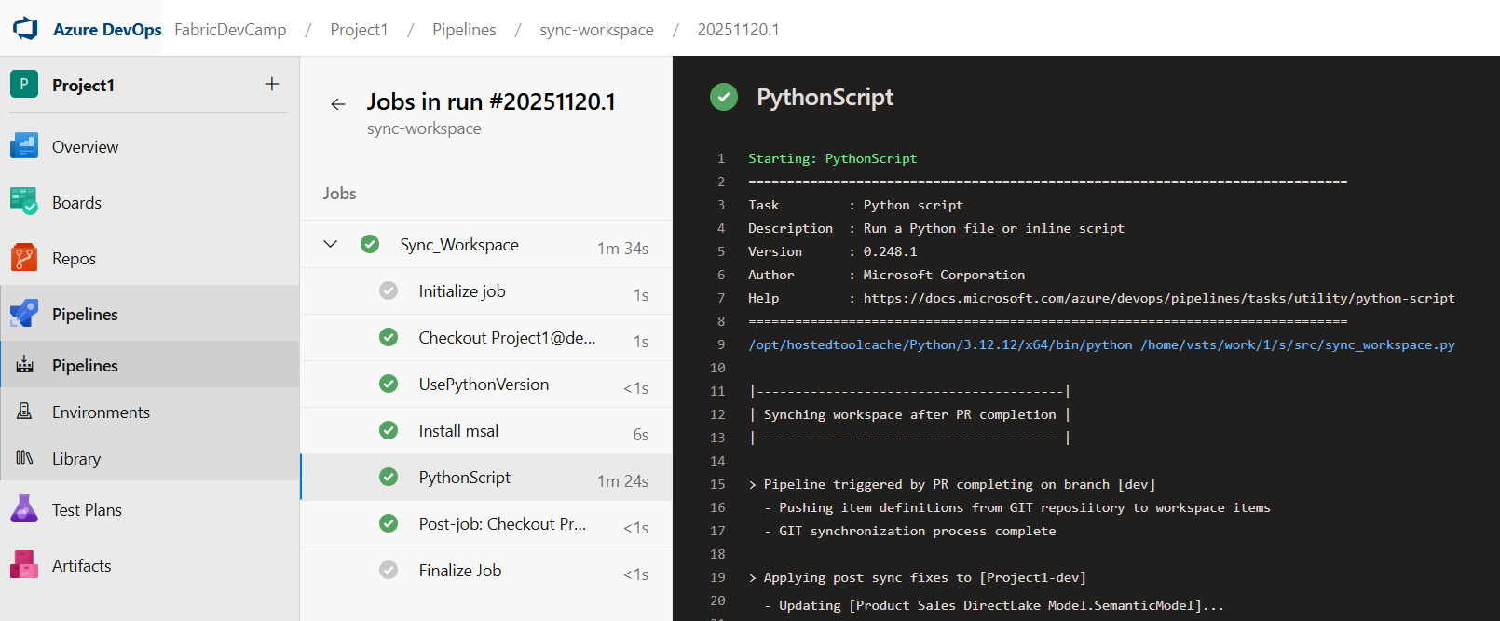

Slide 52
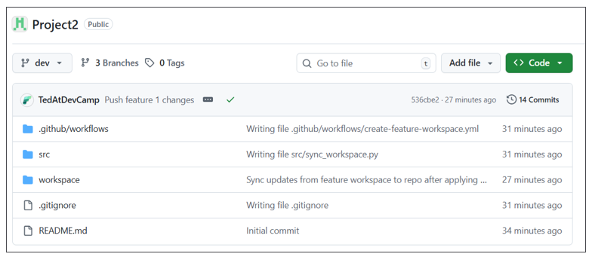

Slide 53
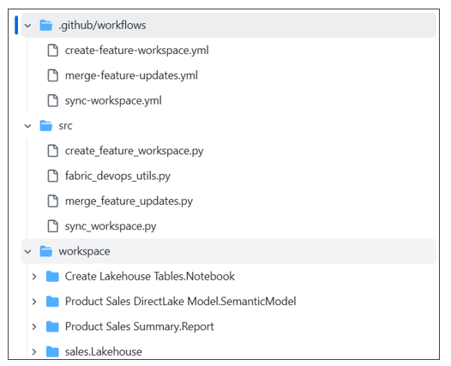

Slide 54
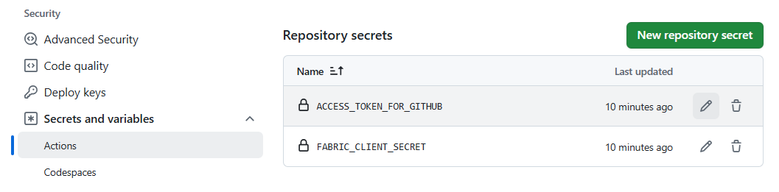

Slide 55
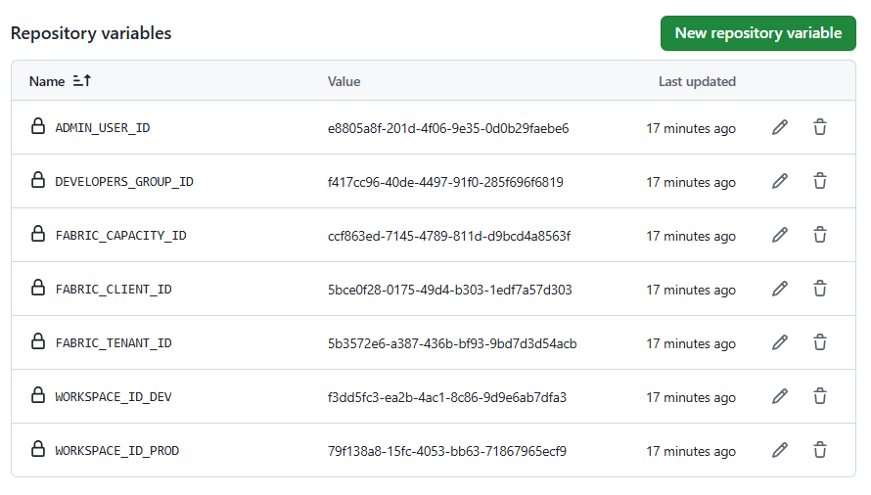

Slide 56
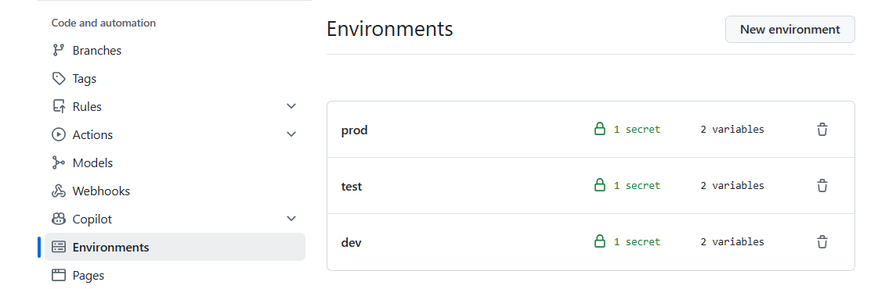

Slide 57
